Slide 1
Principles of Agile Model
Customer satisfaction by early and continuous delivery of useful software
Welcome changing requirements, even late in development
Working software is delivered frequently (in weeks rather than months)
Close daily cooperation between business people and developers
Projects are built around motivated individuals, who should be trusted
Face-to-face conversation is the best form of communication (co-location)
Working software is the principal measure of progress
Sustainable development that is able to maintain a constant pace
Continuous attention to technical excellence and good design
Simplicity—the art of maximizing the amount of work not done—is essential
Self-organizing teams
Regular adaptation to changing circumstances

Slide 2
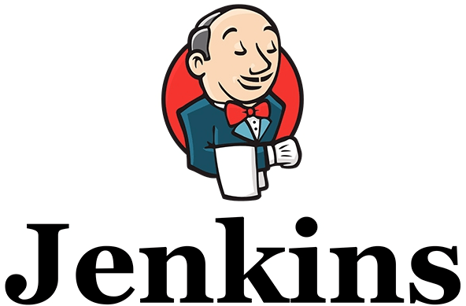
Introduction to
Continuous Integration
&

Slide 3
Agenda
What is SDLC
What is Agile Methodology
What is Continuous Integration
Agile runs on Continuous Integration
Tools required for CI
What is Jenkins
Jenkins versions and Installation Options
Jenkins

Slide 4
What is CI
A cornerstone of DevOps is continuous integration (CI),
a practice of frequently integrating the code of each developer into project integration branch and create a build and run end to end tests on it.
This continual merging prevents a developer’s local copy of a software project from drifting too far afield as new code is added by others, avoiding catastrophic merge conflicts.
The continuous integration principle of agile development has a cultural implication for the development group. Forcing developers to integrate their work with other developers’ work frequently—at least daily—exposes integration issues and conflicts much earlier than is the case with waterfall development.

Slide 5
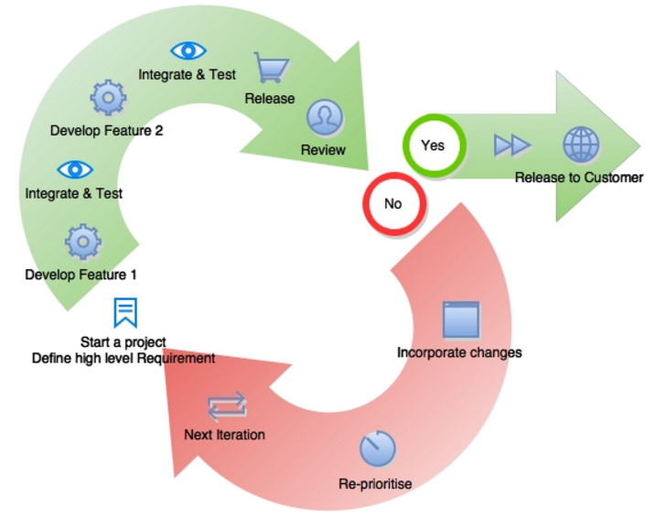
Agile Model

Slide 6
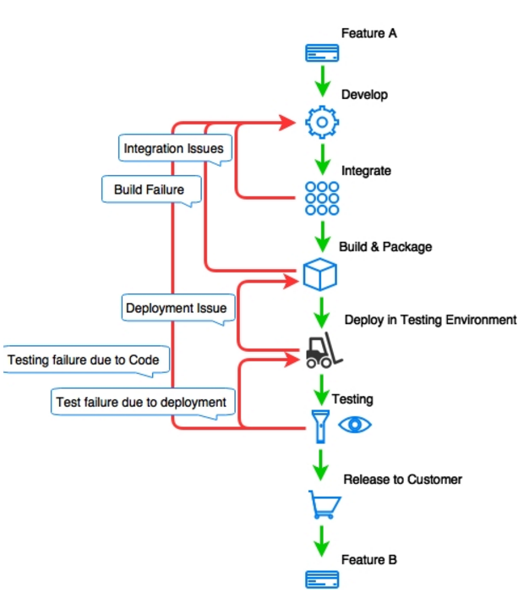
CI Lifecycle

Slide 7
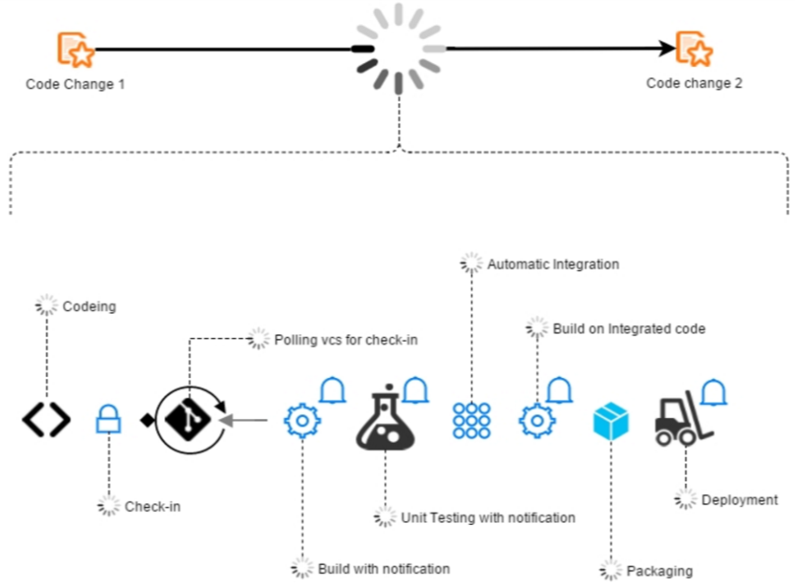
Agile & Continuous Integration
The agile software development process mainly focuses on faster delivery, and Continuous Integration helps it in achieving that speed.
Lets see how does Continuous Integration do it

Slide 8
Jenkins
Jenkins is an open source Continuous Integration tool.
A continuous integration tool is at the centre of the Continuous Integration system and is connected to the version control system tool, build tool, repository tool, testing and production environments, quality analysis tool, test automation tool, and so on.
All it does is an orchestration of all these tools.

Slide 9
Why Jenkins
It is written in Java
It provides extensibility with over 1000+ Plugins for different integrations
It supports Java, .NET, Ruby, Groovy, Grails, PHP, Android, and iOS applications
It is easy to use
It has a simple learning curve and improved with v2
Easy installation
Easy configuration

Slide 10
Jenkins Versions
Jenkins was initially called Hudson and was started in 2004
It was moved out of Oracle and renamed to Jenkins
It was first released in 2011
Jenkins version 2 is released in April 2016
There are compatibility issues between v1 and v2
There are 2 branches in Jenkins
1. LTS ( Long term Support) – Released every 12 week
2. Latest build – Released every week

Slide 11
Common Tools Used in CI
Version Control System
Packaging Tool
Continuous Integration Tools
Build Tools
Automated Deployment Tools
Static Code Analysis Tools
Automated testing
Virtualization & Cloud

Slide 12
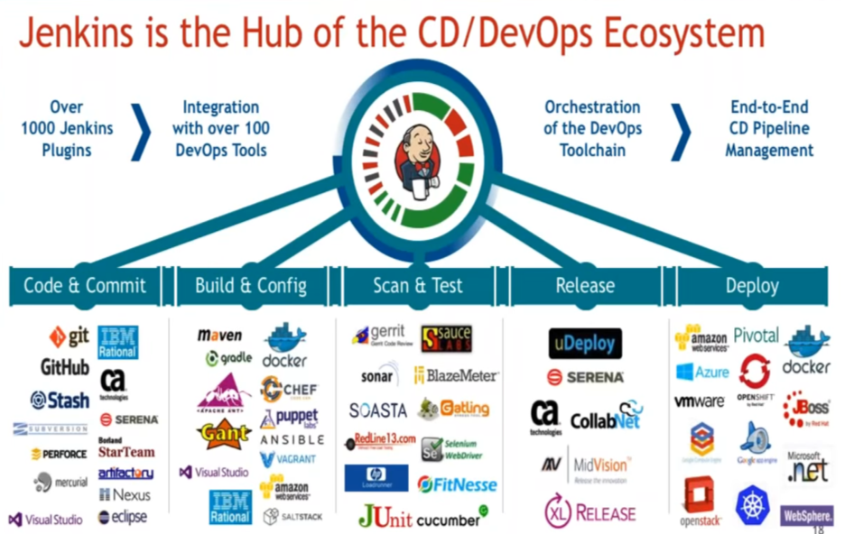
Jenkins Ecosystem

Slide 13
Jenkins Requirements
Minimum Recommended Configuration:
Java 7
256MB free memory
1GB+ free disk space
Recommended Configuration for Small Team:
Java 8
1GB+ free memory
50GB+ free disk space
Requirements shoot up fast with increase in number of builds

Slide 14
Jenkins Installation
Jenkins is provided as a simple java WAR file
Jenkins can be run/installed in 4 ways.
Using java command
Installing Jenkins using rpm as a system service
Running inside an Application Server
Installing inside Docker containers

Slide 15
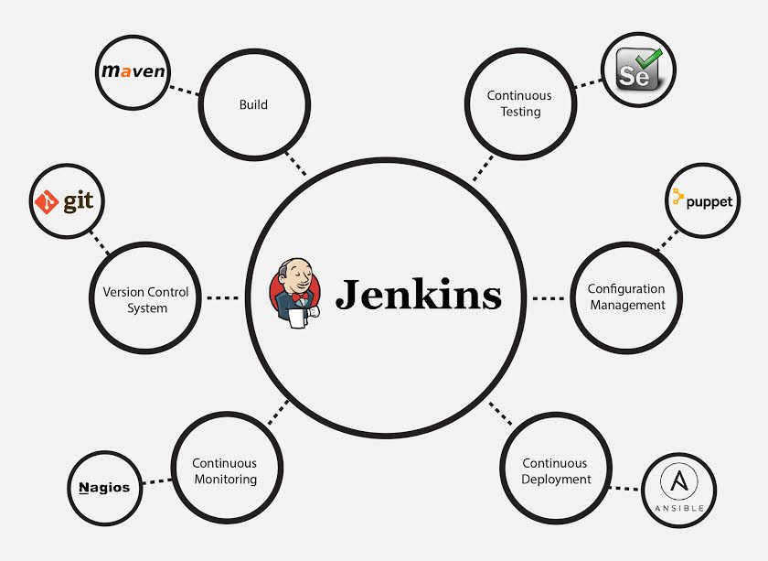
Why Jenkins

Slide 16
Q & A

